Slide 1
Introduction and Overview
Section 1

Slide 2
1
2
3
AC
( )
%
÷
4
5
6
7
8
9
×
7
8
9
4
5
6
−
*
0
#
1
2
3
+
0
,
←
=
Notes:
I use this and the next two slides as a thematic introduction and raise the question of why phone buttons and calculators have differently arranged number blocks. This is a good way to involve the audience by asking them to open the corresponding screens (dial keys and calculator) on their own smartphones and compare the key layouts.
Icon telephone handset: Microsoft Corporation, PowerPoint icon library, free reuse permitted – https://support.microsoft.com/en-us/office/insert-icons-in-microsoft-365-e2459f17-3996-4795-996e-b9a13486fa79

Slide 3
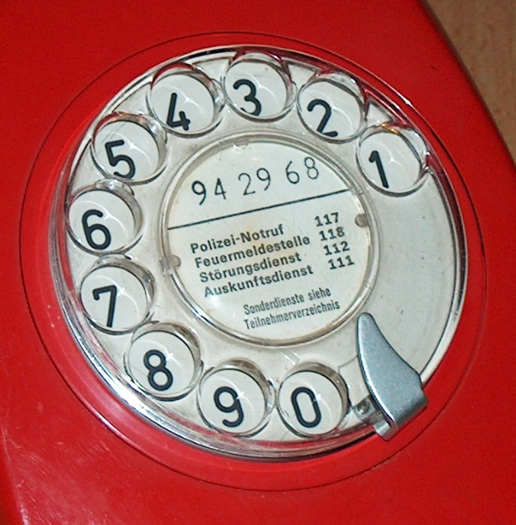
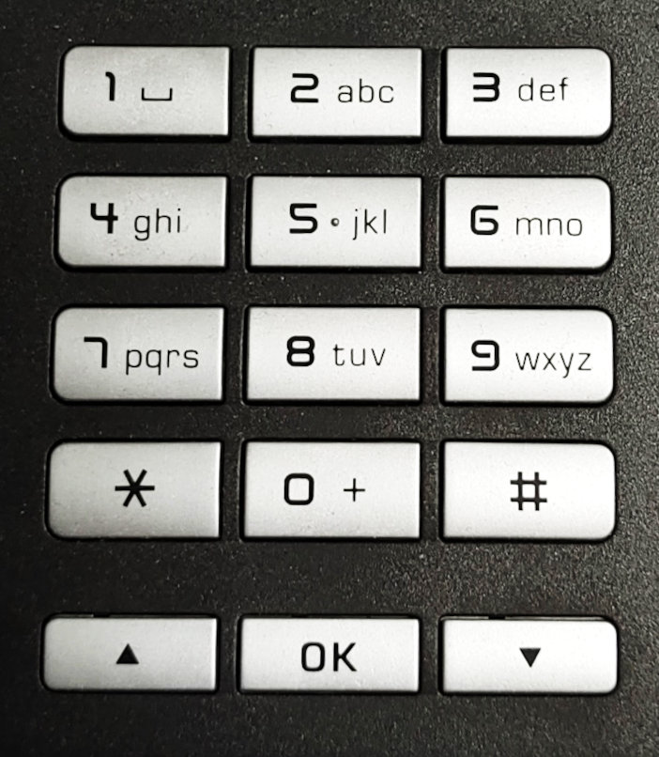
Notes:
The telephone key layout goes back to the first push-button telephones from the end of the 1950s at Bell Labs (USA); before that, telephones had dialing dials.
Phone with rotary dial: User:Gestumblindi, 2004/2008, Wikimedia Commons / CC-0 – https://commons.wikimedia.org/wiki/File:Waehlscheibe-kurzwahlnummern.jpg
Push-button phone: My own photo of a Unify OpenStage 15 T, Julian Fietkau, 2024

Slide 4
3
2
1
2
3
7
8
9
4
1
4
5
6
4
5
6
5
7
8
9
1
2
3
6
0
0
7
0
8
9
1
5
2
4
0
1
2
3
4
5
3
4
5
6
7
3
9
6
7
8
9
0
8
2
8
9
1
7
0
6
R. L. Deininger et al., 1960: Human factors engineering studies of the design and use of pushbutton telephone sets, The Bell System Technical Journal, vol. 39, no. 4
Notes:
Here are some of the key layouts that were empirically examined in the comparative study by Deininger et al. These include both the telephone layout we are familiar with today (top left) and the calculator layout (top center). The layout ultimately selected was not the best in every respect, but was chosen as a compromise.

Slide 5
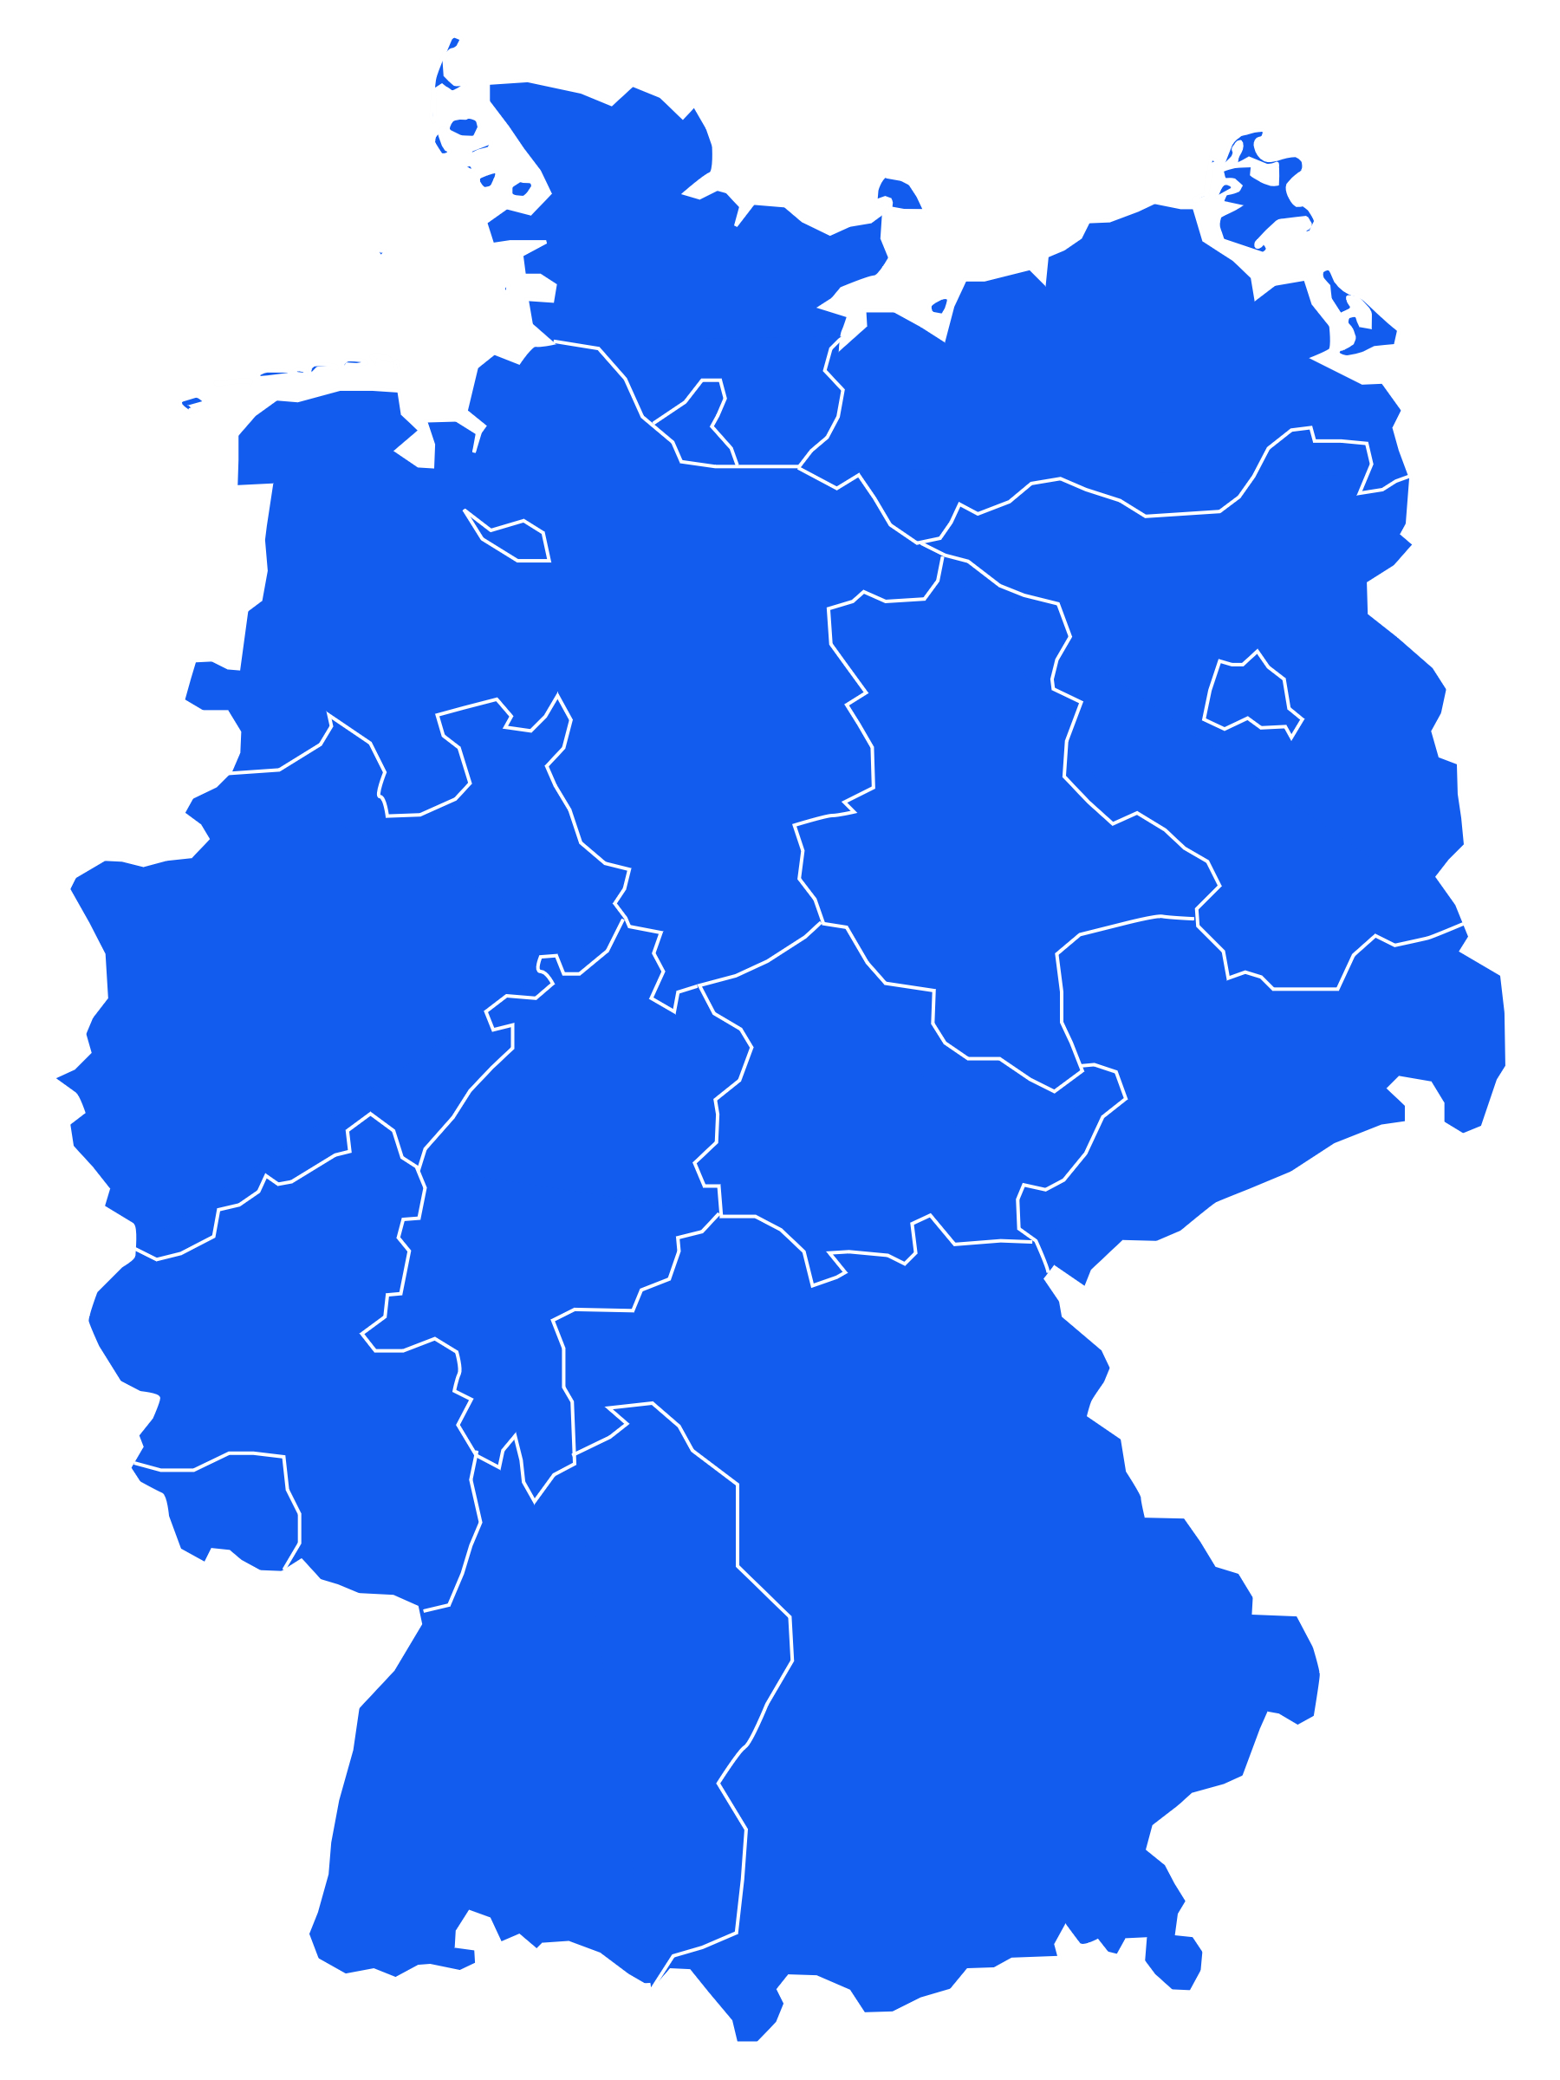
Introduction: Julian Fietkau
2007–2015: University of Hamburg
Computer science (B.Sc. & M.Sc.)
Specializing in human-computer interaction
2015–2016: Bauhaus University, Weimar
Research associate at the chair for human-computer interaction
2016–now: University of the Bundeswehr Munich
Research associate at the chair for human-computer interaction
Doctorate (Dr. rer. nat.) in computer science, 2023
Researching: usage and usability of public or semi-public interactive technology (especially large touch displays) for different target audiences
https://fietkau.me
https://fietkau.social/@julian
Notes:
This slide should of course be adapted by the individual presenter. I encourage a “personal touch” here, the presentation should be designed to your personal vibe depending on your communication style, career, and professional focus.
Map of Germany: User:Mmrw, 2020, Wikimedia Commons / CC-0 – https://commons.wikimedia.org/wiki/File:Karte_gruenes_deutschland.svg
Icons position marker, laptop: Microsoft Corporation, PowerPoint icon library, free reuse permitted – https://support.microsoft.com/en-us/office/insert-icons-in-microsoft-365-e2459f17-3996-4795-996e-b9a13486fa79
Mastodon logo: Eugen Rochko and Team, 2022, via Wikimedia Commons / GNU AGPL v3 – https://commons.wikimedia.org/wiki/File:Mastodon_logotype_(simple)_new_hue.svg

Slide 6
Round of Introductions
Name, major / degree / job / company
Your understanding of the word “human-computer interaction”
Requests and expectations for this course
Notes:
Icon question: Microsoft Corporation, PowerPoint icon library, free reuse permitted – https://support.microsoft.com/en-us/office/insert-icons-in-microsoft-365-e2459f17-3996-4795-996e-b9a13486fa79

Slide 7
What is Part of HCI?
gamification
social software
interaction research
VR, AR, XR
hardware design
ubiquitous computing
interaction design
usability
user experience
creativity
rigorous methods
psychology
biology
sociology
computer science
design
ergonomics
Notes:
HCI is primarily based on computer science, psychology, and design (although the latter can be controversial depending on who you ask). Other disciplines tend to play a smaller role. The findings integrated in this way flow through the two pillars of creativity and the rigorous application of methods and fan out to form the diverse manifestations of HCI – from classic usability and UX to the experimental development of new interaction modalities. The exact terms in the treetop are not decisive here and could also be collected collaboratively instead of keeping this preset.
Clip art: tree, flooredmusic, 2013, Openclipart, public domain – https://openclipart.org/detail/184451/tree

Slide 8
My Attempt at a Topology
UX research
Systematic context analysis, requirements engineering, evaluation of design processes
common empirical methods
Human-computer interaction (HCI)
Also: human-technology interaktion (HTI)
Academic field between computer science and psychology which investigates the influence that humans and digital technology have on one another
bolsters/researches
researches
User experience
What is it like (subjectively) to use a (specific) interactive system
designs
influences
UX design
The process of constructively/creatively designing an interactive system with a focus on UX
researches
Usability
A measure of how useful, practical, easy to use a specific system is
Out in the world: lots of different things under the same name, lots of the same things under different names. I recommend not to get too hung up on the exact word choice.
Some specific definitions (referring to important standards) in a bit!

Slide 9
Content of an Introductory Course
2.3.1 Nature of Human-Computer Interaction (N)
N1. The Nature of Human-Computer Interaction
2.3.2 Use and Context of Computers (U)
U1. Social Organization and Work
U2. Application Areas
U3. Human-Machine Fit and Adaptation
2.3.3 Human Characteristics (H)
H1. Human Information Processing
H2. Language, Communication and Interaction
H3. Ergonomics
2.3.4 Computer System and Interface Architecture (C)
C1. Input and Output Devices
C2. Dialogue Techniques
C3. Dialogue Genre
C4. Computer Graphics
C5. Dialogue Architecture
2.3.5 Development Process (D)
D1. Design Approaches
D2. Implementation Techniques and Tools
D3. Evaluation Techniques
D4. Example Systems and Case Studies
Thomas T. Hewett et al., 1992: ACM SIGCHI Curricula for Human-Computer Interaction, Association for Computing Machinery
Notes:
I recommend not only quoting the general curriculum recommendation (as I did here), but also linking it to the learning objectives from the syllabus of your specific course. In my experience, there is usually a lot of overlap, but there can also be surprising differences in the details.

Slide 10
My Own Plan for this Course
n sessions (including today), fixed topic for each date
Time slots contain lecture-like segments with informational content, interactive discussions and mini-exercises, as well as more extensive exercises in individual or team work.
Please have a pen and paper with you for the lecture sessions, even if you do not normally take handwritten notes.
I recommend working on the lecture content afterwards rather than in advance.
The lecture dates are planned in such a way that they are understandable for undergraduate students of computer science without having to read the slides in advance. I therefore recommend that you use your self-study time to go through the content again after a lecture and check your own understanding.
Note: the slides alone (without attendance and your own notes) are not guaranteed to be suitable for self-study. If you are unable to attend the course, self-study will require increased use of the book recommendations and additional research of your own.
Now: further introduction to usability, then a course overview
Notes:
The number of sessions obviously depends on your course’s parameters. In my experience, around 11 to 13 sessions is ideal, but I've also had to make do with eight.
Normally I try not to put so many full sentences on a slide, but this specific slide is intended to be 100% clear and comprehensible after the fact even for course participants who are not present for my commentary.

Slide 11
Recommendations for Supporting Literature
Don Norman, 2013: The Design of Everyday Things: Revised and Expanded Edition
Steve Krug, 2014: Don‘t Make me Think!
Jef Raskin, 2000: The Humane Interface
John Ferrara, 2012: Playful Design
Notes:
As part of an established course structure, you may have an existing list of recommended literature, which in that case should also be contextualized here. As a general recommendation, I list four of my favorite books from the field.

Slide 12
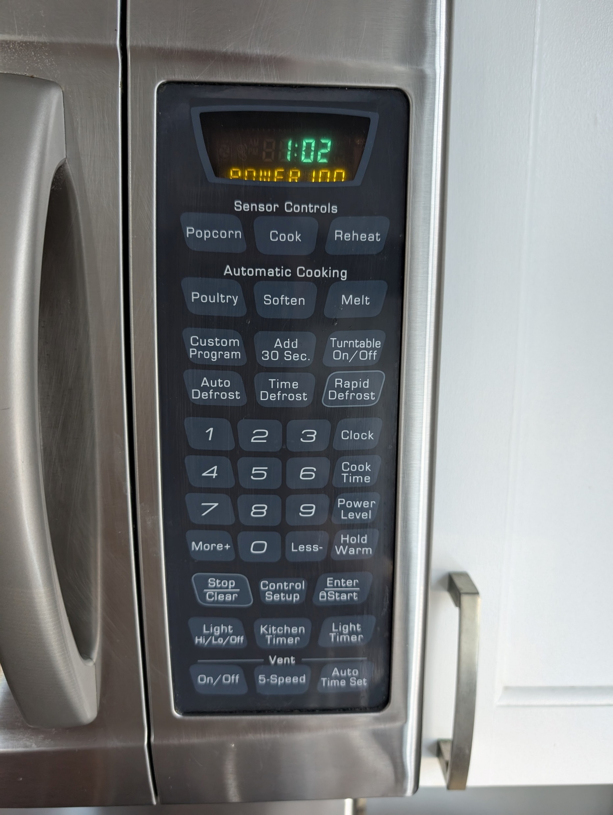
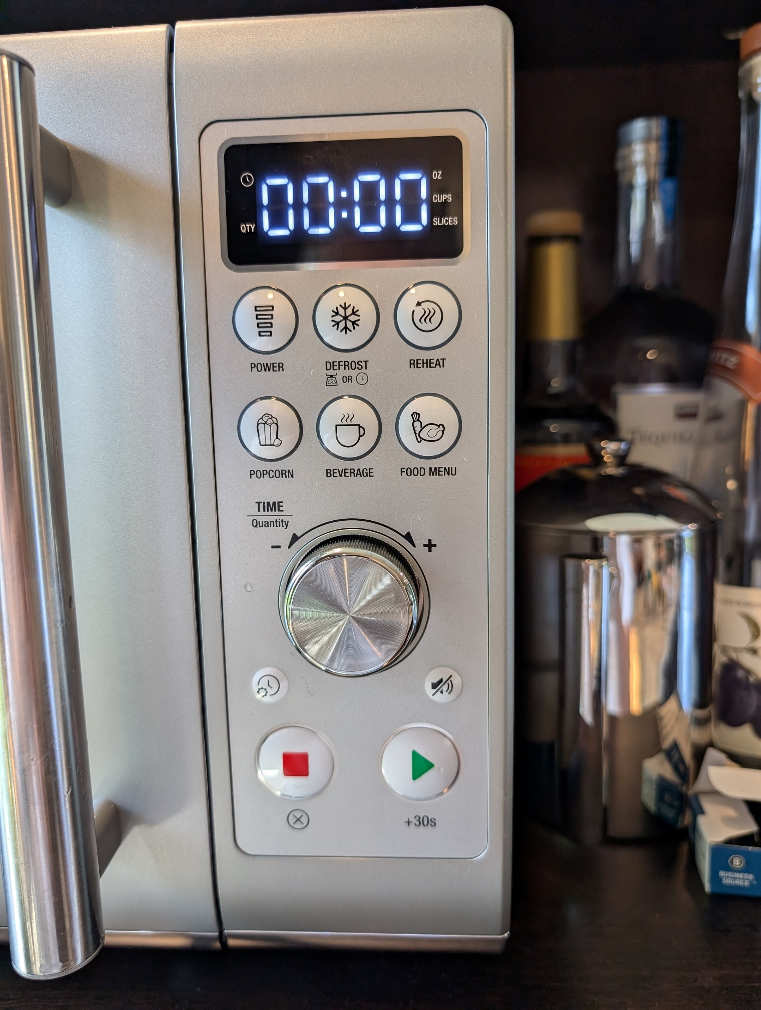
Usability – Everyday Examples
vs.
Scott Jenson, 2024: Microwave comparison, Mastodon / CC BY-SA 4.0

Slide 13
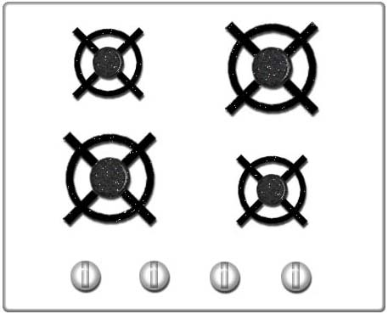
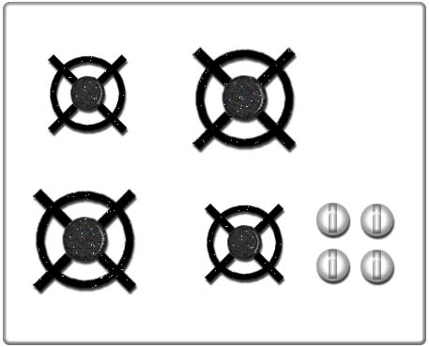
Usability – Everyday Examples
An interaction design classic: stovetop controls
User:G5dvdyeh, 2008: Old style kitchen stove & Kitchen stove with full natural mappings controls, Wikimedia Commons / FAL 1.3

Slide 14
Case Study – Iran Air 655
July 4, 1988
The Washington Post
Navy Missile Downs Iranian Jet Liner Over Gulf; Iran Says 290 Are Dead; U.S. Expresses Regret
Pentagon Says Radar on Aegis Cruiser Mistook Airbus for Attacking F14
Washington Post, July 4 1988
Aegis Combat System Mk7, US Navy, 1988
Kyra Dempsey, 2022: The Long Shadow of War: The story of the shootdown of Iran Air flight 655, Medium
Notes:
As a contrast to the rather lighthearted previous slides, at this point I give a fairly detailed account of the downing of Iran Air 655 and how, according to the Fogarty report and the Pentagon’s evaluation, the situation was facilitated by specific usability problems in the Aegis computer system. Poor usability is not the only cause – I also mention that there are later accounts that contradict the Fogarty report. However, I want to be clear here that we are focusing specifically on usability in the context of this event and are not dealing with the incident in its entirety. What matters is the causal link between the poorly designed user interface and the loss of life.
For speakers who would prefer to present an example without a military background, THERAC-25 would also be suitable.
Crew members monitor radar screens in the combat information center aboard the guided missile cruiser USS VINCENNES (CG-49): US government, public domain. DNST9304318 – https://catalog.archives.gov/id/6486540

Slide 15
Usability – Definition
Usability from use/usage and ability
Usability is the extent to which a product can be used by specified users to achieve specified goals with effectiveness, efficiency, and satisfaction in a specified context of use.
ISO 9241‐11:2018

Slide 16
Usability – Definition
Usability is the extent to which a product can be used by specified users to achieve specified goals with effectiveness, efficiency, and satisfaction in a specified context of use.
ISO 9241‐11:2018
Effectiveness: accuracy and completeness of achieving the goal
Efficiency: the cost (time, effort, resources) is low in relation to the result
Satisfaction: using the system fulfills the expectations of the person who is using it

Slide 17
Discussion: Usability
Can you think of an example from your everyday life where you have been annoyed by poor usability?
How was the effectiveness, efficiency or satisfaction affected in that case?
What are possible consequences of poor usability in everyday life?

Slide 18
HCI – Definition
Human-computer interaction is a discipline concerned with the design, evaluation and implementation of interactive computing systems for human use and with the study of major phenomena surrounding them.
Thomas T. Hewett et al., 1992: ACM SIGCHI Curricula for Human-Computer Interaction, Association for Computing Machinery

Slide 19
HCI – Definition
Human-computer interaction includes:
Understanding how people interact with computers and what happens in the process
Designing and implementing new ways for people to interact with computers
The term “computer” here can mean a desktop computer, but also includes laptops, tablets, cell phones, digital glasses or a variety of other interactive electronics. It refers to both the software and hardware involved.
HCI research involves both behavioral science (observing and understanding) and design science (constructing and evaluating).
Philip Guo, 2012: Clarifying Human-Computer Interaction, Communications of the ACM Volume 57, Number 2

Slide 20
We now proceed to the preview…
Notes:
Red curtain: Tommybuddy, 2015, Pixabay / CC-0 – https://pixabay.com/illustrations/vorhang-rot-bühne-theater-939464/

Slide 21
Section 2: Basics of Cognition
Nervous system
Thinking and planning
Learning and remembering
Mental models
Intuition, intuitive use
Design metaphors
Notes:
Icon brain: Microsoft Corporation, PowerPoint icon library, free reuse permitted – https://support.microsoft.com/en-us/office/insert-icons-in-microsoft-365-e2459f17-3996-4795-996e-b9a13486fa79

Slide 22
Section 3: Perception and Communication
Sensory modalities
Visual perception
Image recognition
Surface recognition
Object recognition
Category recognition
Communication
Basic semiotics
Parts of a language system
Acts of communication
Notes:
Icon eye: Microsoft Corporation, PowerPoint icon library, free reuse permitted – https://support.microsoft.com/en-us/office/insert-icons-in-microsoft-365-e2459f17-3996-4795-996e-b9a13486fa79

Slide 23
Section 4: Guidelines for Interaction Design
Laws
Standards and norms
Heuristics
Style Guides
Notes:
Icon check list: Microsoft Corporation, PowerPoint icon library, free reuse permitted – https://support.microsoft.com/en-us/office/insert-icons-in-microsoft-365-e2459f17-3996-4795-996e-b9a13486fa79

Slide 24
Section 5: The Usability Engineering Process
Purpose of process models
User-Centered Design
Process phases
Perspectives on UCD
Human-Centered Design
Contextual Design
Central questions
Process
Participatory Design
Notes:
Icon signage: Julian Fietkau, 2024

Slide 25
Section 6: Context Analysis
Observational studies
Contextual inquiry
Diary studies
Personas
Use cases
Notes:
Icon magnifying glass: Microsoft Corporation, PowerPoint icon library, free reuse permitted – https://support.microsoft.com/en-us/office/insert-icons-in-microsoft-365-e2459f17-3996-4795-996e-b9a13486fa79

Slide 26
Section 7: Design and Prototyping
Generating ideas
Design methods
Kinds of prototypes
Paper prototypes
Digital prototyping tools
Notes:
Icon idea: Microsoft Corporation, PowerPoint icon library, free reuse permitted – https://support.microsoft.com/en-us/office/insert-icons-in-microsoft-365-e2459f17-3996-4795-996e-b9a13486fa79

Slide 27
Section 8: Evaluation
Purpose of evaluation
Evaluation methods
Questionnaires
Interviews
Observational studies
etc.
Choosing methods
Planning an evaluation
Notes:
Icon discussion: Microsoft Corporation, PowerPoint icon library, free reuse permitted – https://support.microsoft.com/en-us/office/insert-icons-in-microsoft-365-e2459f17-3996-4795-996e-b9a13486fa79

Slide 28
Section 9: Interaction Paradigms
Specifics of the different “worlds”
PC / laptop
Mobile
Web
Extended Reality (XR)
Conversational UI
Notes:
Icon desktop PC: Microsoft Corporation, PowerPoint icon library, free reuse permitted – https://support.microsoft.com/en-us/office/insert-icons-in-microsoft-365-e2459f17-3996-4795-996e-b9a13486fa79

Slide 29
Section 10: Computer-Supported Cooperative Work
Basic concepts
Shared tools and spaces
Communication via computers
Social platforms
Notes:
Icon network: Microsoft Corporation, PowerPoint icon library, free reuse permitted – https://support.microsoft.com/en-us/office/insert-icons-in-microsoft-365-e2459f17-3996-4795-996e-b9a13486fa79

Slide 30
Section 11: Accessibility
What is accessibility
Common handicaps
Technical aids
Accessible web development
Notes:
Icon accessibility: Microsoft Corporation, PowerPoint icon library, free reuse permitted – https://support.microsoft.com/en-us/office/insert-icons-in-microsoft-365-e2459f17-3996-4795-996e-b9a13486fa79

Slide 31
Section 12: Information Architecture and Data Visualization
Information architecture
Principles
Navigation patterns
Data visualization
Principles
Scales, dimensions, axes
Diagram types
Notes:
Icon bar chart: Microsoft Corporation, PowerPoint icon library, free reuse permitted – https://support.microsoft.com/en-us/office/insert-icons-in-microsoft-365-e2459f17-3996-4795-996e-b9a13486fa79

Slide 32
Section 13: Visual Design
Colors
Basic color theory
Color spaces
Color palettes
Graphics
Raster graphics
Vector graphics
File formats
Typography
Fonts
Text formatting
Notes:
Icon palette: Microsoft Corporation, PowerPoint icon library, free reuse permitted – https://support.microsoft.com/en-us/office/insert-icons-in-microsoft-365-e2459f17-3996-4795-996e-b9a13486fa79

Slide 33
Section 14: HCI over Time
History of interactive systems
Groundbreaking user interfaces
Forgotten highlights
HCI methods over the decades
What is the current “HCI zeitgeist”?
Where are we headed?
Notes:
Icon calendar: Microsoft Corporation, PowerPoint icon library, free reuse permitted – https://support.microsoft.com/en-us/office/insert-icons-in-microsoft-365-e2459f17-3996-4795-996e-b9a13486fa79

Slide 34
Section 15: Professional Values and Ethics
What are the ethical boundaries of HCI and UX?
What responsibilities do we shoulder?
What professional values do we embody?
How do they manifest in our work?
Notes:
Icon handshake: Microsoft Corporation, PowerPoint icon library, free reuse permitted – https://support.microsoft.com/en-us/office/insert-icons-in-microsoft-365-e2459f17-3996-4795-996e-b9a13486fa79

Slide 35
Overview
1 | Introduction and Overview
2 | Basics of Cognition
3 | Perception and Communication
4 | Guidelines for Interaction Design
5 | The Usability Engineering Process
6 | Context Analysis
7 | Design and Prototyping
8 | Evaluation
9 | Interaction Paradigms
10 | Computer-Supported Cooperative Work
11 | Accessibility
12 | Information architecture and data visualization
13 | Visual Design
14 | HCI over Time
15 | Professional Values and Ethics
Part I: Fundamentals
What context does HCI take place in? What are we working with?
Part II: Methods
What do we do? In what order? What are our success criteria?
Part III: Expertise
What else should we be aware of and what are ways to specialize?
Part IV: Reflection
What do we need to understand about ourselves?

